Slide 1
IoT indoor positioning system for disabled people
Scientific Python

Slide 2
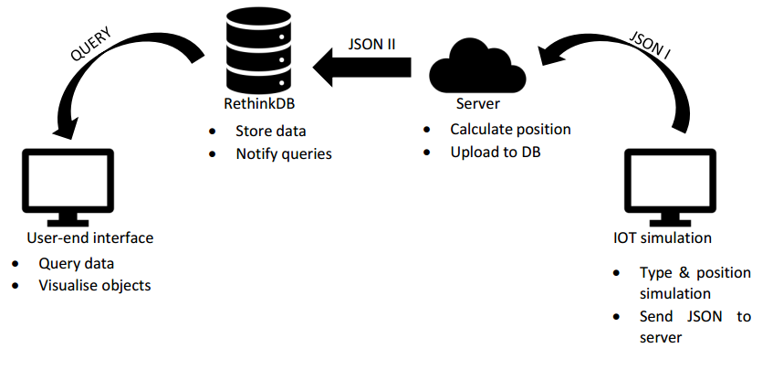
About our project

Slide 3

RethinkDB
Insert with JSON format
Automatic update in real time
NonSQL
Python, JS compatible

Slide 4
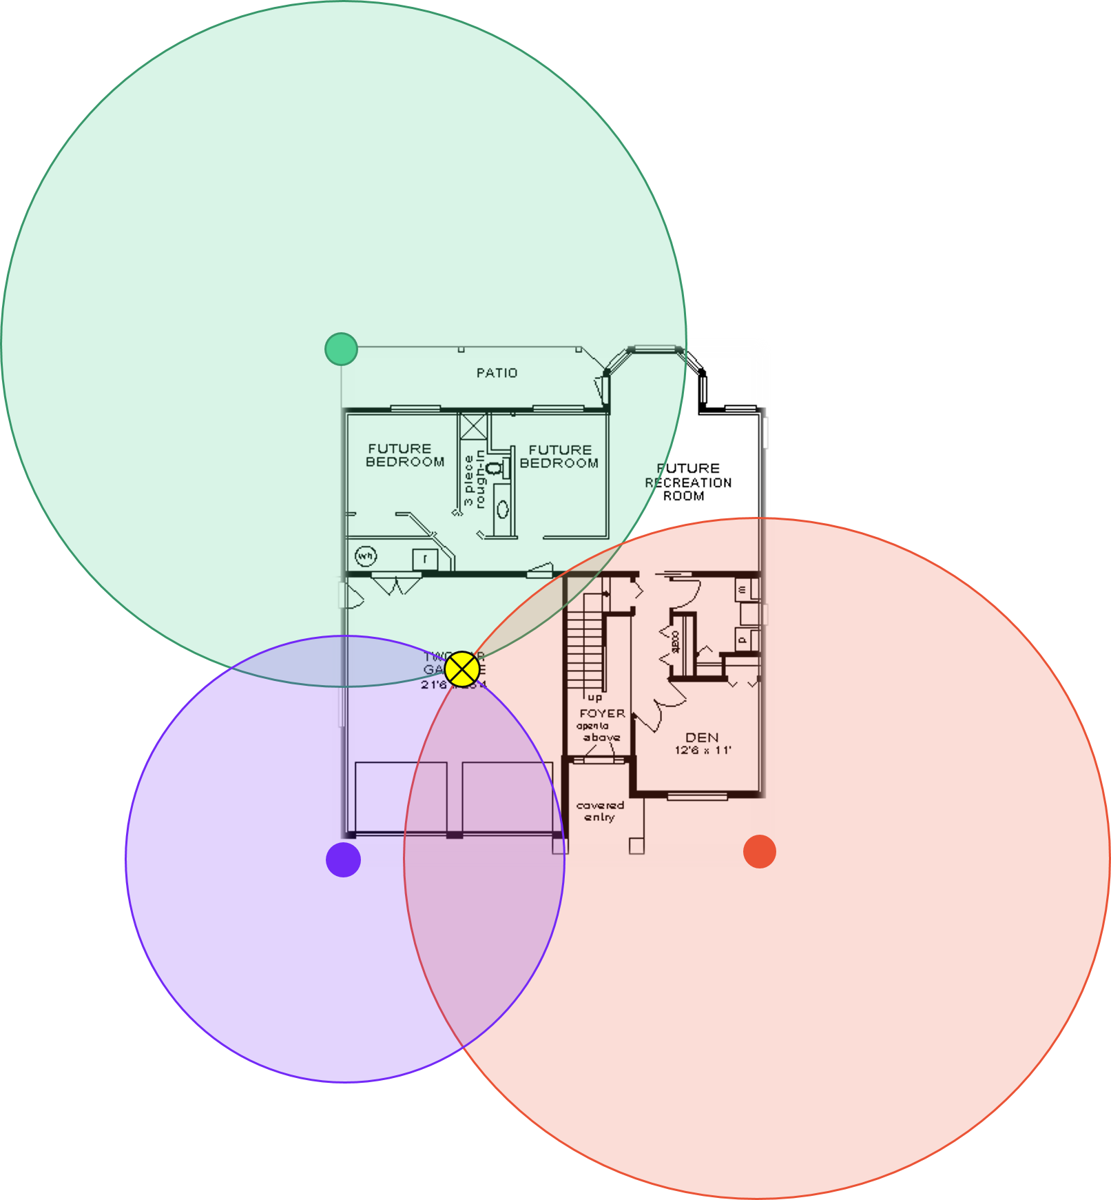
Server
Get time of flights from sensors
Calculate the intersect point
Upload X, Y coordinates to database

Slide 5
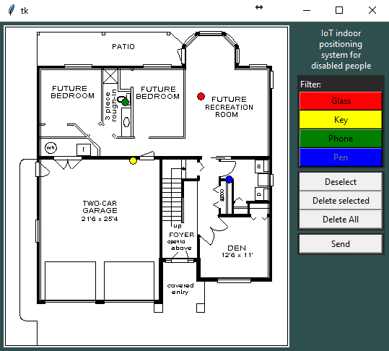
Sensor simulation
No low-energy bluetooth
Simulate it
Need a GUI to place the objects
Sensors in the corners (except the left bottom)

Slide 6
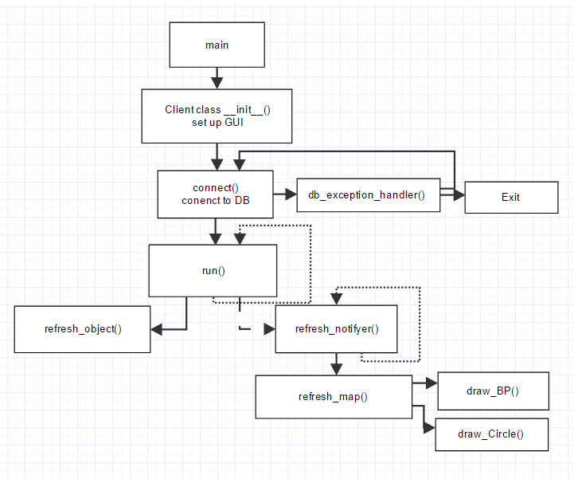
User-end interface
Update info from database in real time
3 thread

Slide 7
Thank you your attentions

